Slide 1

DATA 410 – Assignment 7 Final Presentation
Adebukola Aina

Slide 2
1 – Business Understanding –High Level
Notes:
For the High Level Business Understanding focus on the Case Study supplied.

Slide 3
Case Study
…The Alberta to British Columbia Trans Mountain Expansion Project | Open Case Studies
The Alberta to British Columbia Trans Mountain Expansion Project

Slide 4
Introduction
The Trans Mountain Expansion Project (TMEP) was an initiative aimed at increasing the capacity of the existing Transmountain pipeline, which transports crude oil from Alberta to British Columbia. The aim was to triple the pipeline's daily capacity.However, this expansion has been met with several oppositions as a result of the environmental and social threats it poses.
This case study examines the key aspects of the TMEP, including its economic, environmental and social implications and also the regulatory challenges and stakeholders perspectives.

Slide 5
5W 1H Analysis 1 – Who
# | Question | Answer
Q1.1 | Who is involved? | The Government of Canada ,the Kinder Morgan company, The Tsleil Waututh First Nation,The Squamish Nation
Q1.2 | Who is affected? | The Government of Canada ,the Kinder Morgan company, The Tsleil Waututh First Nation,The Squamish Nation
Q1.3 | Who will benefit? | The Government of Canada and the Kinder Morgan company
Q1.4 | Who will be harmed? | The Tsleil Waututh First Nation,The Squamish Nation, ocean and wildlife,environment
Notes:
The questions on this slide are sourced from this article:
https://premium.wpmudev.org/blog/a-simple-sure-fire-way-to-create-great-content-the-5-w-the-h/
Who is involved?
Who is affected?
Who will benefit?
Who will be harmed?

Slide 6
5W 1H Analysis 2 – What
# | Question | Answer
Q2.1 | What is your topic narrowed down in a simple phrase/sentence? | The TMEP proposal, the benefits and implications.
Q2.2 | What does your topic involve? (i.e. What are the different parts to it?) | It involves the TMEP proposal, the goals, resistance by the FIRST NATIONS,
Q2.3 | What is it similar to / different from? | NA
Q2.4 | What might be affected/changed by your topic? | This topic intends to shed more light on the Transmountain Pipeline activities, comparing its output with other major pipelines and to study the trend over the years,this would help policy and business decisions.
Notes:
The questions on this slide are sourced from this article:
https://premium.wpmudev.org/blog/a-simple-sure-fire-way-to-create-great-content-the-5-w-the-h/
What is your topic narrowed down in a simple phrase/sentence?
What does your topic involve? (i.e. What are the different parts to it?)
What is it similar to / different from?
What might be affected/changed by your topic?

Slide 7
5W 1H Analysis 3 –When
# | Question | Answer
Q3.1 | When does this take place? When did this take place? When will it take place? When should this take place? | Started in 2013 with the proposal, and the project officially commenced in the wake of covid-19 in 2020
Q3.2 | Does when this takes place affect the topic? | Yes, when it took place affected the topic, as we could see that the cost of the project kept increasing with time
Notes:
The questions on this slide are sourced from this article:
https://premium.wpmudev.org/blog/a-simple-sure-fire-way-to-create-great-content-the-5-w-the-h/
When does this take place? When did this take place? When will it take place? When should this take place?
Does when this takes place affect the topic?

Slide 8
5W 1H Analysis 4 – Where
# | Question | Answer
Q4.1 | Where does this take place? (Where did it …. Where will it … Where should it ….?) | This took place in the provinces of Alberta and British Columbia, where the transmountain pipes connects from Edmonton, Alberta to the WestRidge Marine Terminal in Burnaby, British Columbia.
Q4.2 | Does it matter where it takes place? Is it affected by location? | Yes it is, as the location is the bone of contention among the stakeholders
Notes:
The questions on this slide are sourced from this article:
https://premium.wpmudev.org/blog/a-simple-sure-fire-way-to-create-great-content-the-5-w-the-h/
Where does this take place? (Where did it …. Where will it … Where should it ….?)
Does it matter where it takes place? Is it affected by location?

Slide 9
5W 1H Analysis 5 – Why
# | Question | Answer
Q5.1 | Why is this topic important? Why does it matter? | This topic delves beneath the surface of the project and highlights all the bottlenecks in the project, it also breaks down the Financial, economic, social and environment implications of the project in the long run.
Q5.2 | Why do certain things happen? (What are some causes and effects within the topic?) | The need to increase capacity led to the TMEP. However, from this topic, this project would leave many factors in its wake: algal bloom, GHG emissions, wastewater, dangers to wild and aquatic life, etc
Notes:
The questions on this slide are sourced from this article:
https://premium.wpmudev.org/blog/a-simple-sure-fire-way-to-create-great-content-the-5-w-the-h/
Why is this topic important? Why does it matter?
Why do certain things happen? (What are some causes and effects within the topic?)

Slide 10
5W 1H Analysis 6 – How
# | Question | Answer
Q6.1 | How does this topic work? How does it function? How does it do what it does? | The project intends to triple the Transmountain capacity from 300,000 to 890,000 barrels per day.
Q6.2 | How did it come to be? | It came to be from the initiation of the TMEP proposal
Q6.3 | How are those involved affected? | Some shareholders (Canadian Government) aim to profit from the project, it however poses a negative impact on some other shareholders(Tsleil Waututh First Nations)
Notes:
The questions on this slide are sourced from this article:
https://premium.wpmudev.org/blog/a-simple-sure-fire-way-to-create-great-content-the-5-w-the-h/
How does this topic work? How does it function? How does it do what it does?
How did it come to be?
How are those involved affected?

Slide 11
2 – Data Understanding – High Level

Slide 12
Data Modeling – Conceptual model
GOALS
INCREASE PIPELINE CAPACITY(300%)
2 PIPELINES,
NEW PUMP STATIONS,
STORAGE TANKS, ETC
ACCESS TO GLOBAL MARKETS
INCREASED REVENUE
EMPLOYMENT OPPORTUNITIES
STAKEHOLDERS
TSLEIL-WAUTUTH
GOVERNMENT OF CANADA
KINDER MORGAN COMPANY
RAINCOAST CONSERVATION FOUNDATION
ECONOMIC IMPACT
INCREASED PROJECT COST
AGAINST NEW CLIMATE POLICIES
PROPERTY VALUES DROP
REESTABLISHMENT OF THE TSLEIL-WAUTUTH SUBSITENCE ECONOMY
TMEP PROPOSAL
GOALS
INCREASE PIPELINE CAPACITY
SOCIAL IMPACT
EXPOSURE TO TOXIC AIR EMISSIONS
THREAT TO FOOD SOVEREIGNTY
SEXUAL &DOMESTIC VIOLENCE
THREATS TO CULTURE & INDIGENOUS WAYS
RISK TO SQUAMISH UNCEDED TERRITORY
ENVIRONMENTAL IMPACT
WASTEWATER
GHG EMISSIONS
ALGAL BLOOMS
OIL SPILLS
NOISE POLLUTION
AIR QUALITY
EVENTS
TMEP PROPOSAL(2013)
TMEP APPROVAL (2016)
APPROVAL OVERTURNED(2018)
RE-APPROVAL (2019)
APPEAL DISMISSED(2020)
PROJECT COMMENCEMENT(2020)

Slide 13
Data Dictionary
No | Topic | Definition
1 | TMEP | TransMountain Expansion Project
2 | UNDRIP | United Nations Declaration on the Rights of Indigenous Peoples
3 | TMPL | TransMountain PipeLine
4 | FPIC | Free Prior and Informed Consent
5 | THROUGHPUT | The amount of petroleum product that moves through a particular facility during a given period of time
6 | CAPACITY | The maximum amount of oil/gas that can flow through a pipeline at any given time
7 | ALGAL BLOOM | Caused by nitrogen and phosphorus(from oil spills) increase in the waterbody
8 | SUBSISTENCE ECONOMY | relies on natural resources to provide for basic needs through hunting, gathering, and agriculture.
9 | NEB | National Energy Board
10 | Key point | Location where the pipeline Throughput and Capacity are recorded

Slide 14
1 (Revisited) – Business Understanding – Low Level

Slide 15
Business Questions
Question 1) How did the Transmountain Pipeline Oil Production fare alongside 2 major pipelines ( Enbridge and Keystone) in the last oil boom period of 2007 to 2014?
Question 2)How are the Transmountain pipeline products distributed between IntraCanada and Exports?

Slide 16
2 (Revisited) – Data Understanding – Low Level

Slide 17
Data Set(s)
Transmountain-throughput-and-capacity-dataset
Enbridge-mainline-throughput-and-capacity-dataset
keystone-throughput-and-capacity-dataset

Slide 18
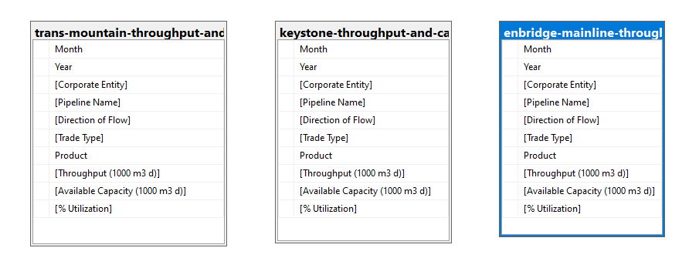
Database Diagram – Tables and Columns
Notes:
Load the Data Set into SQL Server.
Use the SQL Server Management Studio (SSMS) Diagramming tool to produce the Database Diagram.

Slide 19
3 – Data Preparation

Slide 20
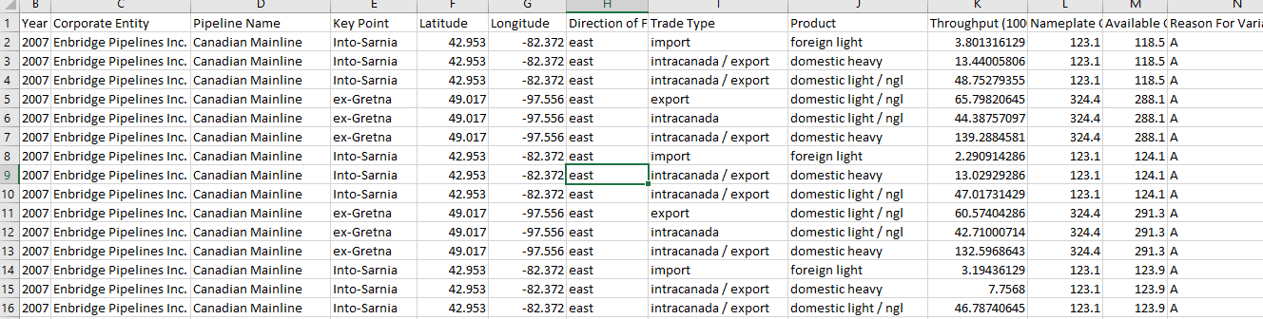
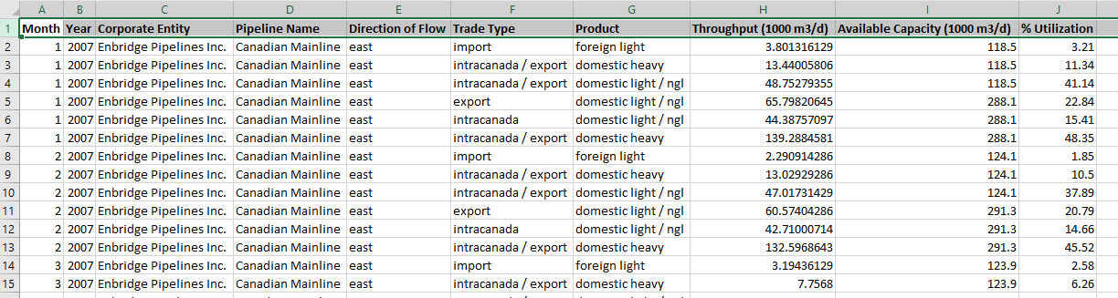
Data Preparation – Data cleansing
ENBRIDGE
Deleted unwanted columns
Added a new column: % Utilization( Throughput/capacity)
*100
Ensured all 3 tables had the same column headers( to ensure successful join statement)
Uploaded successfully on SQL
BEFORE
AFTER
Notes:
Document any data cleansing that was required, any quality issues encountered with the data.

Slide 21
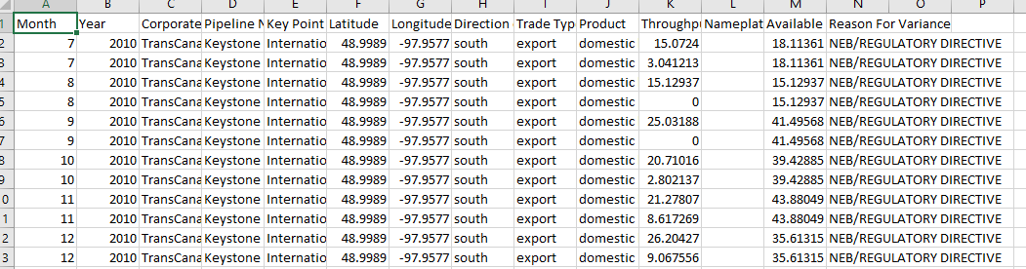
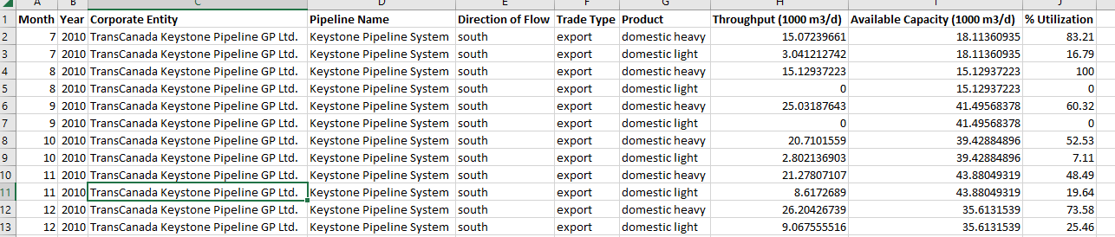
Data Preparation – Data cleansing
KEYSTONE
BEFORE
AFTER
Notes:
Document any data cleansing that was required, any quality issues encountered with the data.

Slide 22
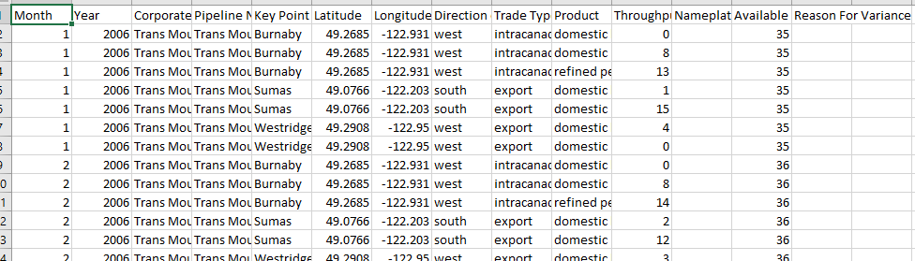
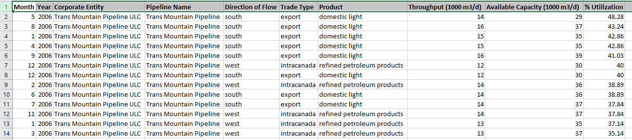
Data Preparation – Data cleansing
TRANSMOUNTAIN
BEFORE
AFTER
Notes:
Document any data cleansing that was required, any quality issues encountered with the data.

Slide 23
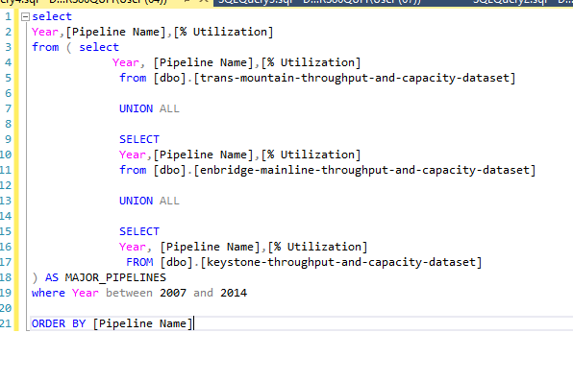
Data Preparation – SQL Query for Question 1
% Utilization for Transmountain, Enbridge and Keystone pipelines during the Oil boom period
Notes:
Use the SQL Server Management Studio (SSMS) tool to produce the SQL Query.
In this slide provide the SQL Query in text format, not screen shot format.

Slide 24
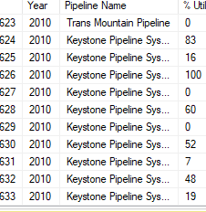
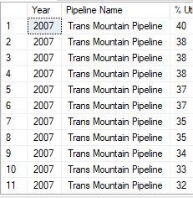
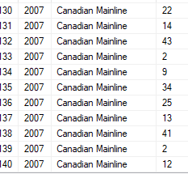
Data Preparation – Data set returned for Query 1
Notes:
Use the SQL Server Management Studio (SSMS) tool to return the results of the SQL Query.
In this slide have a screen shot of the results.

Slide 25
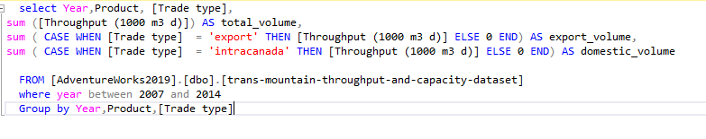
Data Preparation – SQL Query for Question 2
Transmountain Pipeline product distribution between Intra Canada and Export for those periods
Notes:
Use the SQL Server Management Studio (SSMS) tool to produce the SQL Query.
In this slide provide the SQL Query in text format, not screen shot format.

Slide 26
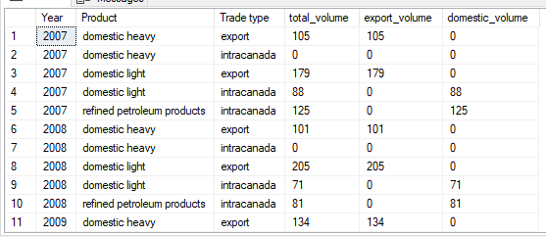
Data Preparation – Data set returned for Query 2
Notes:
Use the SQL Server Management Studio (SSMS) tool to return the results of the SQL Query.
In this slide have a screen shot of the results.

Slide 27
4 – Modeling

Slide 28
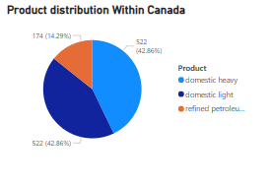
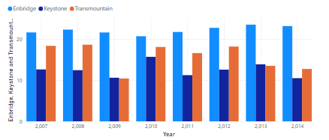
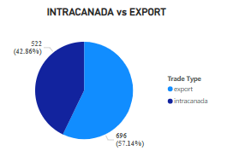
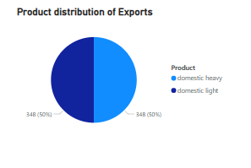
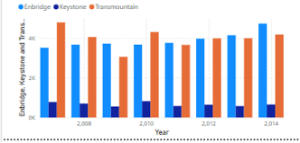
Visualization - Dashboard
% Utilization of 3 major pipelines
Total Utilization of 3 major pipelines
Notes:
Provide a screen shot of the visualization built in Power BI or Tableau.

Slide 29
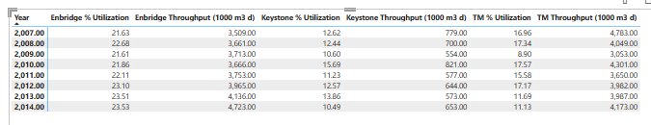
Visualization – Report 1
UTILIZATION AND % UTILIZATION ACROSS 3 MAJOR PIPELINES IN THE OIL BOOM PERIOD OF 2007 - 2014
Notes:
Provide a screen shot of the visualization built in Power BI or Tableau.

Slide 30
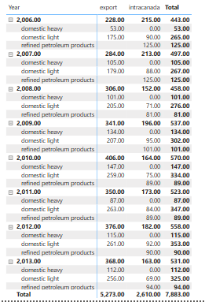
Visualization – Report 2
DISTRIBUTION OF TRANSMOUNTAIN PIPELINE PRODUCTS BETWEEN INTRACANADA AND EXPORT
Notes:
Provide a screen shot of the visualization built in Power BI or Tableau.

Slide 31
5 – Evaluation

Slide 32
Conclusion – Answer to Question 1
During the oil boom period of 2007 to 2014, when compared with the other 2 major pipelines(Enbridge and Keystone), Transmountain had the 2nd highest utilization rate, but the highest production amount, hence played a crucial role in boosting the Canadian economy.
Notes:
The answer to the question from Slide 21 needs to be supported by the data visualized in the previous steps.

Slide 33
Conclusion – Answer to Question 2
Transmountain pipeline products are split between IntraCanada and Exports, with a higher proportion(58%) being exported. This underscores the critical role of the pipeline in balancing domestic supply and export demands. The products being exported are domestic heavy and domestic light, in nearly equal proportion. The refined petroleum produced was distributed domestically, alongside the remaining domestic heavy and domestic light crude oil.
Notes:
The answer to the question from Slide 21 needs to be supported by the data visualized in the previous steps.

